Slide 1
Words of Fortune Terminal App
Tracey Tran

Slide 2
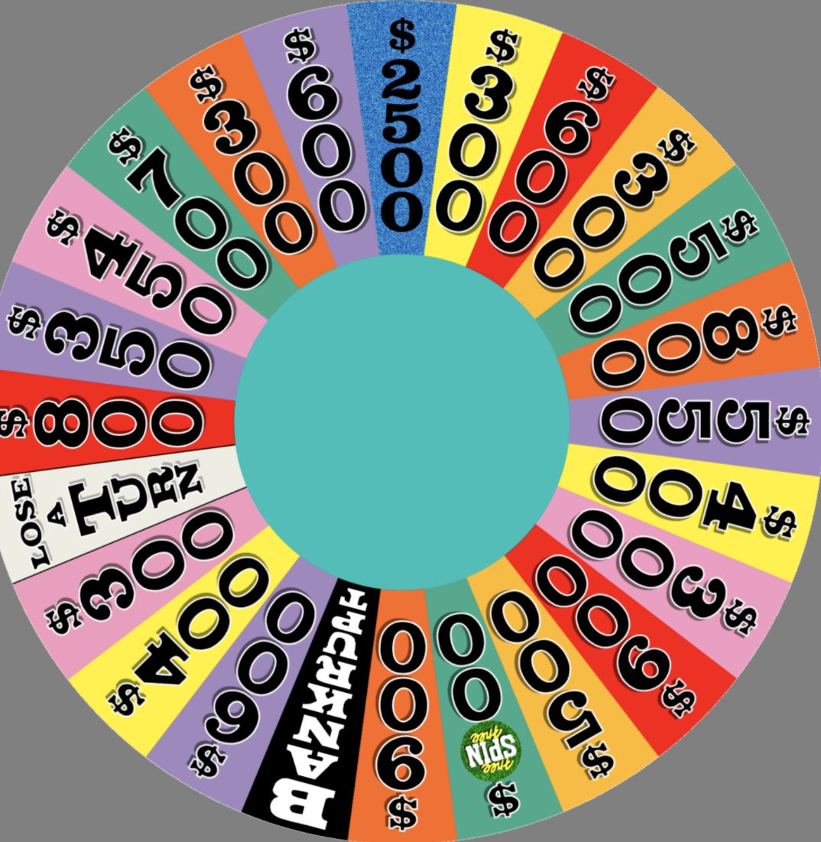
About
- A fun word-puzzle game
- Inspired by TV show Wheel of Fortune and Hangman game
- Purpose to provide a fun way of learning vocabulary and testing your general knowledge

Slide 3
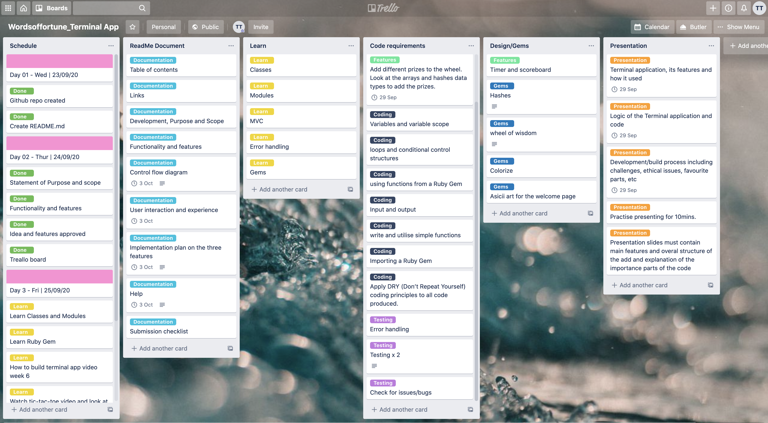
Planning
- Trello board
- Schedule for each day and three main components broken down into bite-size tasks

Slide 4
Features
- Fun exciting word puzzle - User will see the result of each input they enter into the command.
- Spin the wheel - To generate a random prize money
- Scoreboard – Displays the top leaderboard
- Timer during the game - Add a bit of suspense

Slide 5
Challenges
Not starting with MVC and refactoring
One file with multiple modules and classes
Unable to create the spinning wheel animation
Testing
Favourite Parts
- Overall aesthetic of the app and user flow
- Creating an alternative for spinning wheel
- Word game puzzle logic

Slide 6
Demo time!

